Slide 1
Bits & Bots
Anna Gerber

Slide 2
Bits & Bots Sessions
Session | Topic
Tuesday 20th May, 6 – 8pm | Intro to 3D Design: Design custom robot parts to print on the 3D printers
Tuesday 27th May, 6 – 8pm | Intro to Electronics: Learn how the electronic parts in the kit work, design our robot circuits
Tuesday 3rd Jun,e 6 – 8 pm | Intro to Arduino: Write NodeJS programs to read from sensors and control actuators
7th June, 1 – 5 pm | Intermediate 3D Design: Design more complex robot parts: gears, claws etc
14th June, 1 – 5 pm | Intermediate Arduino: Develop our robots' locomotion, sensing and responding behaviours
21st June, 1 – 6 pm | Advanced Bits & Bots: Finalise robot design and assembly, develop advanced robot control programs

Slide 3
Robot Design
A robot is an autonomous system that senses
and responds to, or acts upon the physical world

Slide 4
Chassis
Sensors
(Inputs e.g. ultrasonic sensor)
Power
Control
(Microcontroller = brain)
Actuators
(Outputs e.g. motors)

Slide 5
Designing 3D printable Custom robot parts

Slide 6
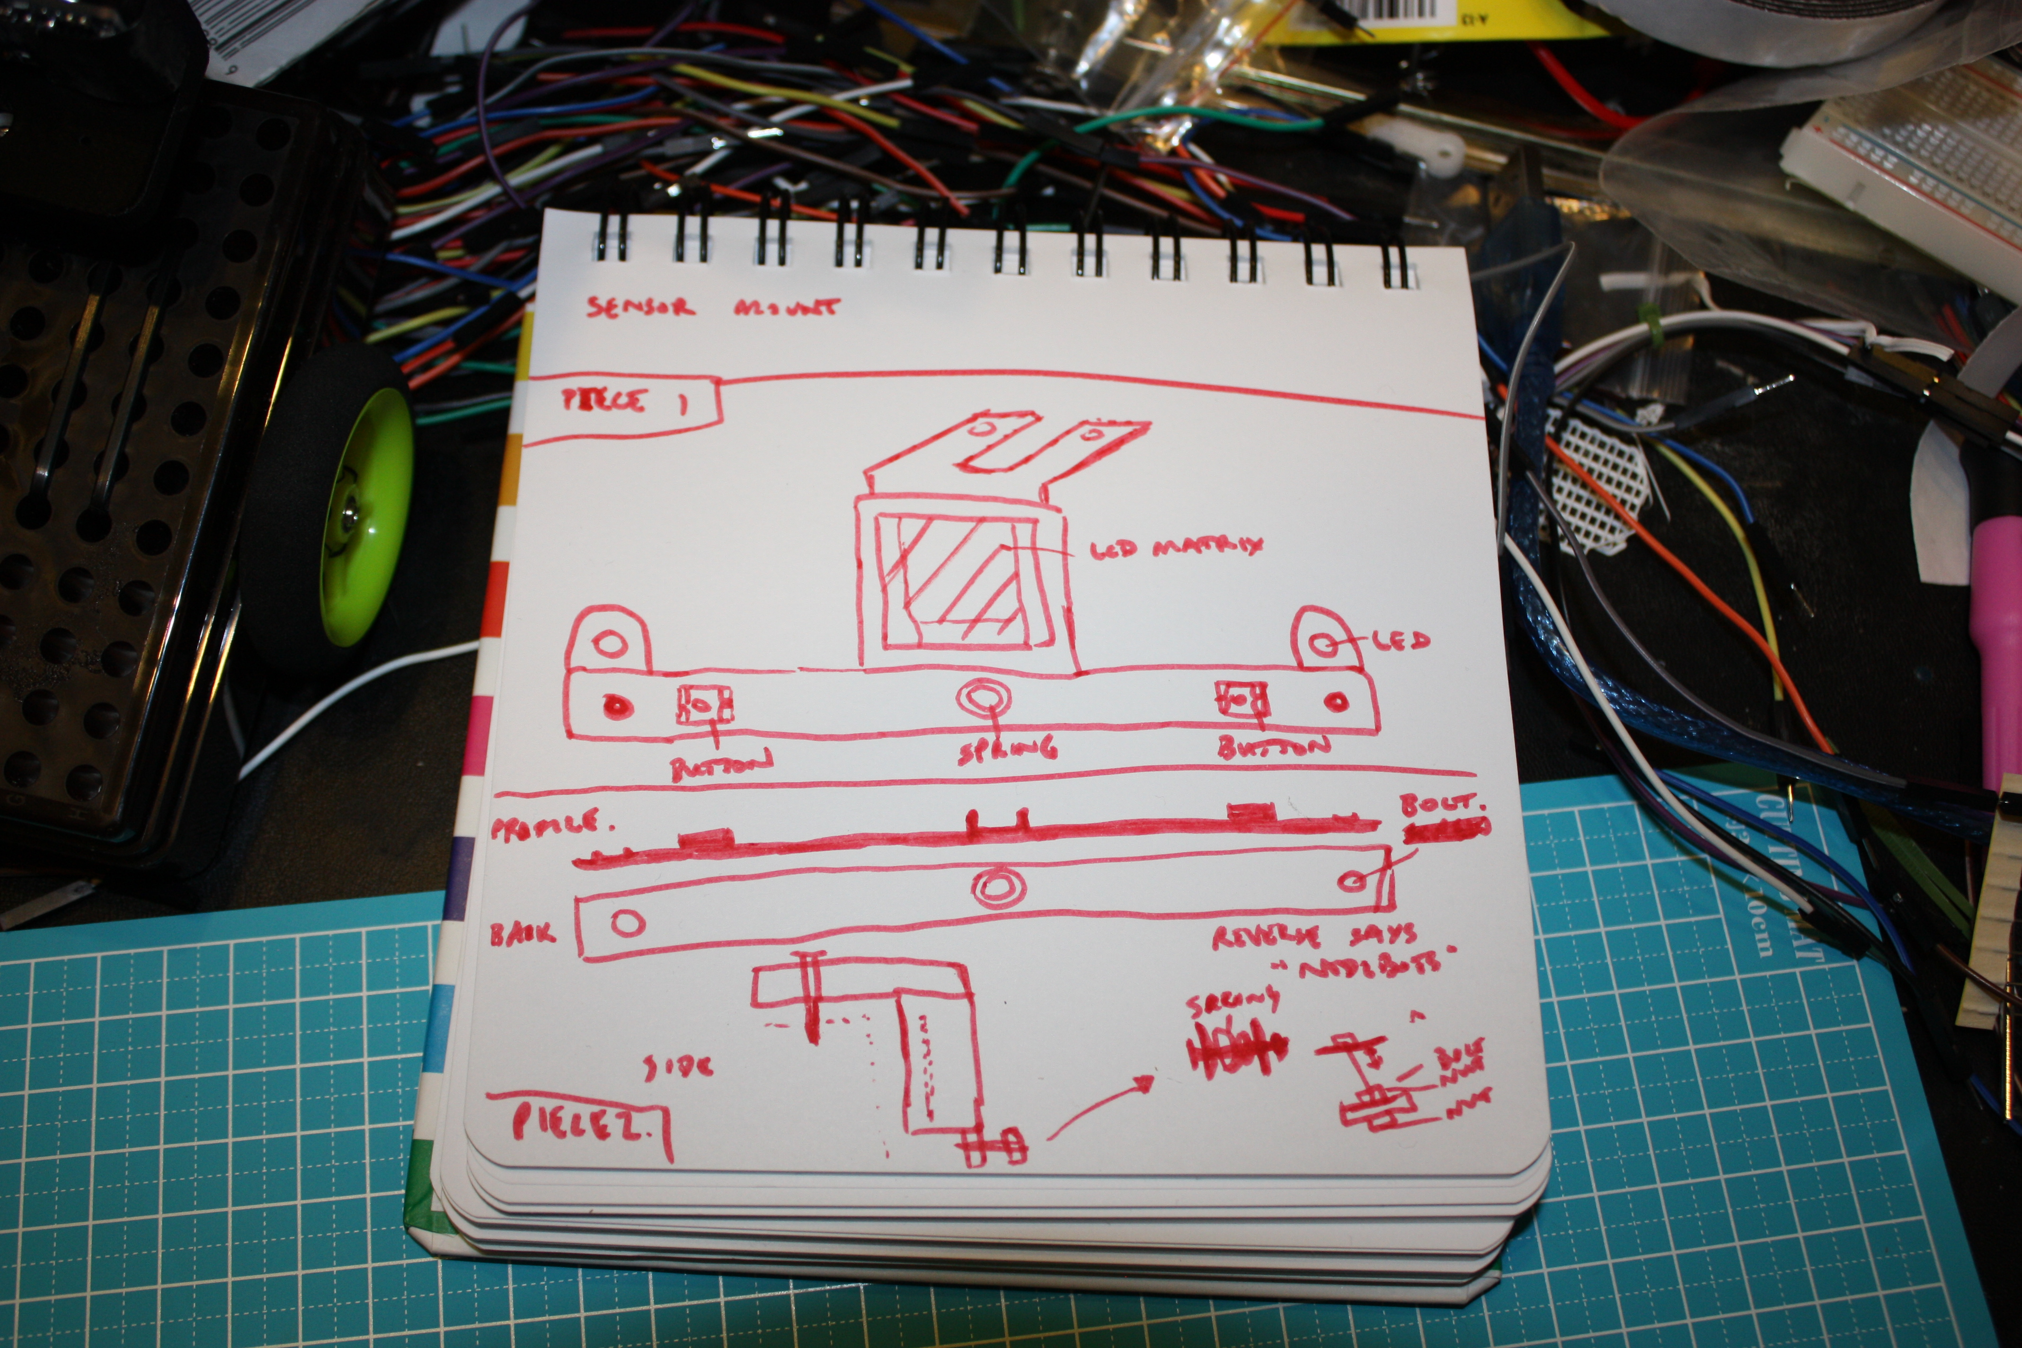
Plan function and layout of part
Use calipers and ruler to measure precise dimensions required

Slide 7
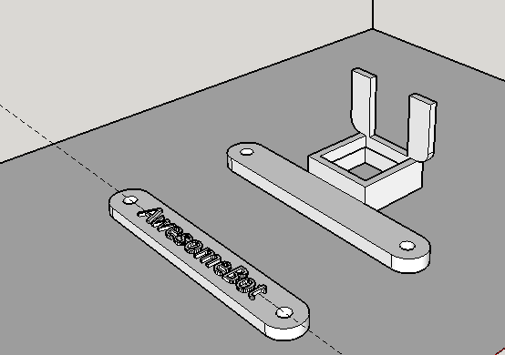
Create the 3D model
Once you are satisfied that the part will function as required, refine the model to improve the appearance and personalise your design

Slide 8
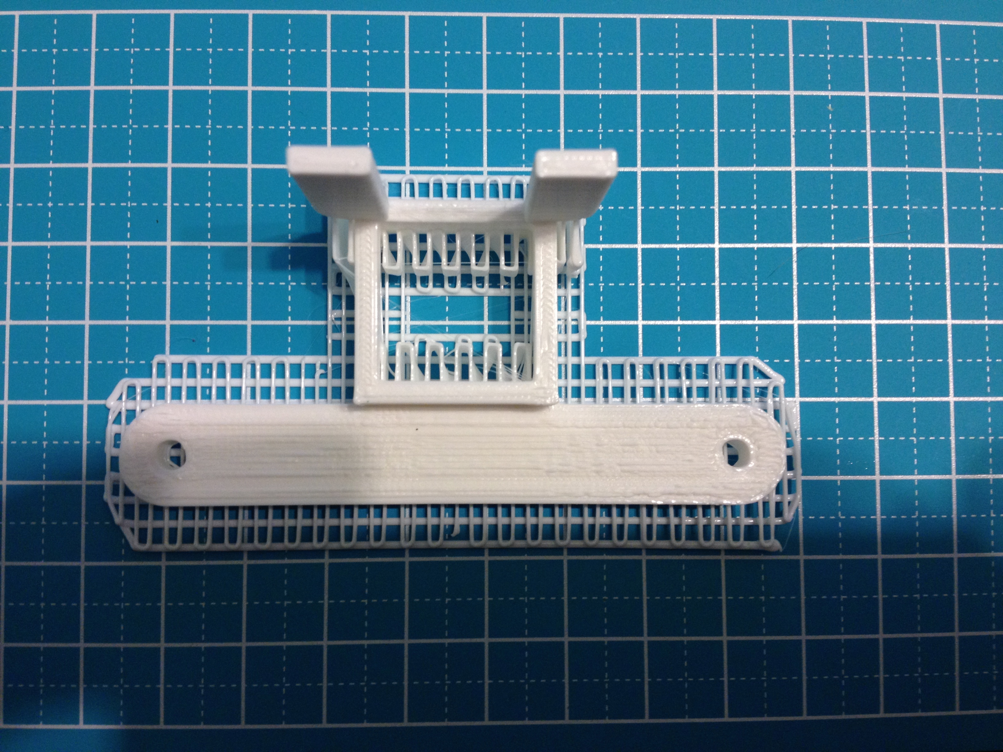
3D print the part

Slide 9
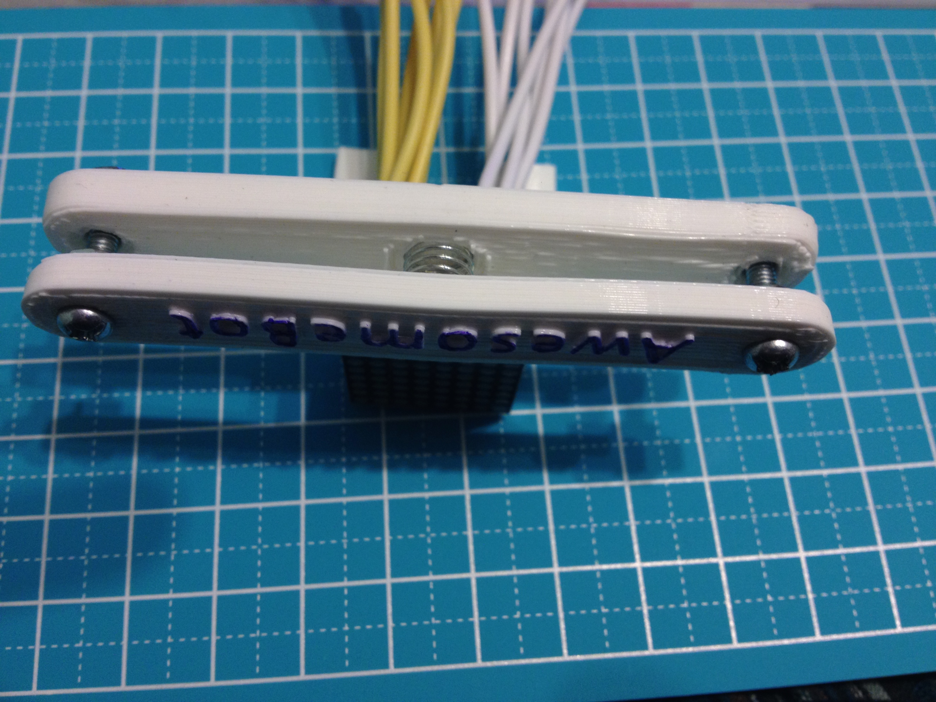
Test and refine
If the part isn't quite right, modify (e.g. using hobby knife, rotary tool) or refine the 3D model and reprint

Slide 10
Bits & Bots Robot Kits
Electronics |  | Chassis
Arduino Nano microcontroller | 20 x jumper wires female – female | small parts box
Mini USB Cable plus USB female to male extension cable | 10 x jumper wires male – female | small spring for bumper
3 x 9g servo for arm/head | 4 x male-male jumper wires (long) | 2 x wheels
ultra sonic sensor | 13 x jumper wires male - male (short) | cable ties
piezo element | led matrix | wire for affixing wheels
medium breadboard | photo resistor | plastic chassis frame
mini breadboard | 2 x 5mm super bright LEDs
RGB LED (common cathode) | 16 x 330 ohm resistor
2 x push buttons | 2 x continuous rotation servos for wheels
battery holder with switch | 2 x shift registers
4 x AA Batteries | row of 15 header pins

Slide 11
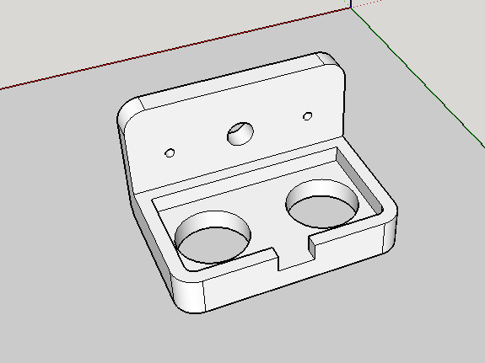
Exercise: Designing a 3D Model
We will design a 3D printable mount to attach our ultrasonic sensor to a servo motor to allow it to be rotated
You can download Sketchup Make from http://www.sketchup.com/

